Slide 1
EE227 – Digital Logic Design
Lecture 13

Slide 2
Outline
Types of logical circuits
Combinational
Sequential
Combinational Circuits
Analysis Procedure
Design Procedure
Binary Adder – Subtractor
Half Adder – Subtractor
Full Adder – Subtractor

Slide 3
Types of Logical Circuits
Logic circuits for digital systems may be:
Combinational
A combinational circuit consists of logic gates whose outputs at any time are determined from only the present combination of inputs
Sequential
Sequential circuits employ storage elements in addition to logic gates. Their outputs are a function of the inputs and the state of the storage elements
The outputs of a sequential circuit depend not only on present values of inputs, but also on past inputs

Slide 4
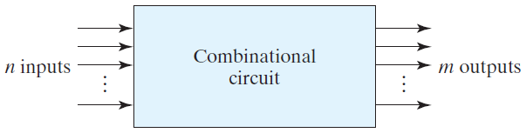
Combinational Circuits (1/3)
A combinational circuit consists of an interconnection of logic gates
A block diagram of a combinational circuit is shown
The n input binary variables come from an external source; the m output variables are produced by the internal combinational logic circuit and go to an external destination
Inputs and outputs are physical signals

Slide 5
Combinational Circuits (2/3)
For n input variables, there are 2^{n} possible combinations of the binary inputs
Thus, a combinational circuit can be specified with a truth table that lists the output values for each combination of input variables
A combinational circuit also can be described by m Boolean functions
One function for each output variable
Each output function is expressed in terms of the n input variables

Slide 6
Combinational Circuits (3/3)
There are several combinational circuits that are employed extensively in the design of digital systems
These circuits are available in integrated circuits and are classified as standard components
Here, we will discuss the most important standard combinational circuits, such as adders, subtractors, comparators, decoders, encoders, and multiplexers

Slide 7
Analysis Procedure (1/2)
The analysis of a combinational circuit requires that we determine the function that the circuit implements
This task starts with a given logic diagram and ends with a set of Boolean functions, a truth table, or, possibly, an explanation of the circuit operation
The first step in the analysis is to make sure that the given circuit is combinational and not sequential
The diagram of a combinational circuit has logic gates with no feedback paths or memory elements
A feedback path is a connection from the output of one gate to the input of a second gate

Slide 8
Analysis Procedure (2/2)
Once the logic diagram is verified to be that of a combinational circuit, one can proceed
To obtain the output Boolean functions from a logic diagram, we proceed as follows:
Label all gate outputs that are a function of input variables with arbitrary symbols — but with meaningful names. Determine the Boolean functions for each gate output
Label the gates that are a function of input variables and previously labeled gates with other arbitrary symbols. Find the Boolean functions for these gates
Repeat the process outlined in step 2 until the outputs of the circuit are obtained
By repeated substitution of previously defined functions, obtain the output Boolean functions in terms of input variables

Slide 9
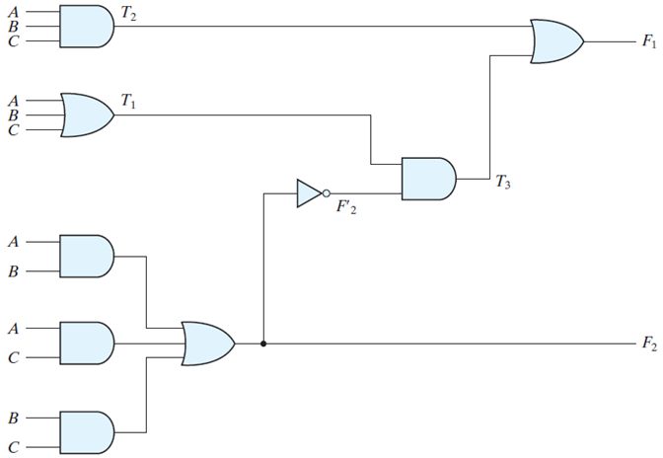
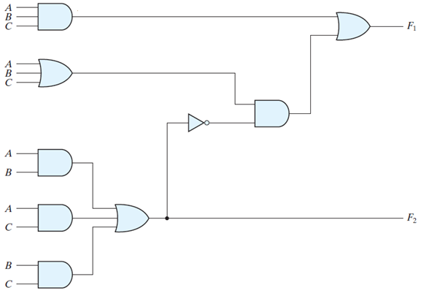
Analysis Procedure (Example)
Obtain the Boolean Expression and Truth Table of the following circuit

Slide 10
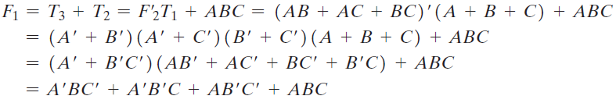
Explanation of Previous Example
Step 1
Label the output of each gate
Step 2
Write the function which are only dependent of input variables
F₂ = AB + AC + BC T₁ = A + B + C T₂ = ABC
Step 3
Define the outputs of gates that are a function of already defined symbols
T₃ = F’₂T₁ F₁ = T₃ + T₂
Step 4
To obtain F1 as a function of A , B , and C , we form a series of substitutions as follows

Slide 11
Obtaining the Truth Table
There are two types of columns in the truth table of a combinational circuit
Follow these steps to obtain the truth table of a combinational circuit
Determine the number of input variables in the circuit
Label the outputs of selected gates with arbitrary symbols
Obtain the truth table for the outputs of those gates which are a function of the input variables only
Proceed to obtain the truth table for the outputs of those gates which are a function of previously defined values until the columns for all outputs are determined

Slide 12
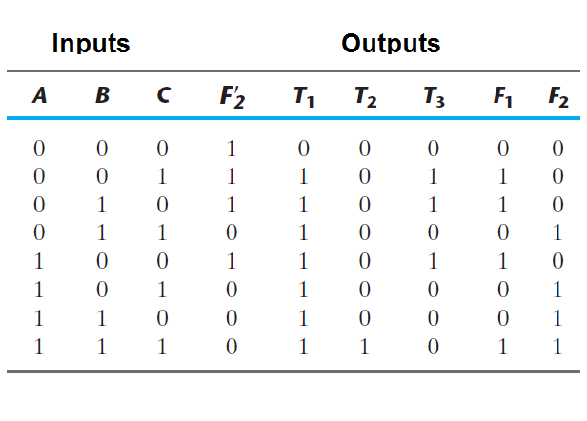
Truth Table of Previous Example

Slide 13
Design Procedure
The design of combinational circuits starts from the specification of the design objective and the procedure involves the following steps
Determine the required number of inputs and outputs and assign a symbol to each
Derive the truth table that defines the required relationship between inputs and outputs
Obtain the simplified Boolean functions for each output as a function of the input variables
Draw the logic diagram and verify the correctness of the design

Slide 14
Considerations for a Practical Design
The output binary functions are simplified by any available method, such as algebraic manipulation, the map method, or a computer-based simplification program
Frequently, there is a variety of simplified expressions from which to choose
A practical design must consider such constraints as:
The number of gates
Number of inputs to a gate
Propagation time of the signal through the gates
Number of interconnections
Limitations of the driving capability of each gate
Any other criteria when designing integrated circuits
Since the importance of each constraint is dictated by the particular application, it is difficult to make a general statement about what constitutes an acceptable implementation

Slide 15
Binary Adder – Subtractor
Digital computers perform a variety of information-processing tasks
Among the functions encountered are the various arithmetic operations
The most basic arithmetic operation is the addition of two binary digits
Binary numbers are added bit by bit
To add two binary numbers we need to add two or three bits at a time
A combinational circuit that performs the addition of two bits is called a half adder
One that performs the addition of three bits (two significant bits and a previous carry) is a full adder

Slide 16
Designing a Half Adder – Subtractor (1/3)
This simple addition consists of four possible elementary operations:
0 + 0 = 0
0 + 1 = 1
1 + 0 = 1
1 + 1 = 10
The MSB in 4th case is called a carry and the bits other than the carry are called sum
Let S is the sum and C is carry

Slide 17
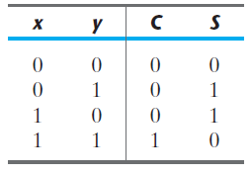
Designing a Half Adder – Subtractor (2/3)
The truth table of the half adder can be written as
And from the truth table we can write the equations for S and C
S = x’y + xy’ C = xy

Slide 18
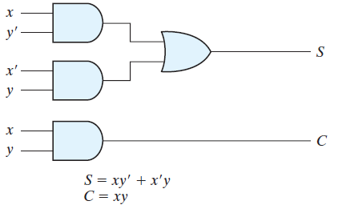
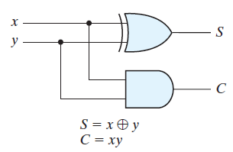
Designing a Half Adder – Subtractor (3/3)
The Boolean Expressions obtained are already simplified and no further simplification is possible
Now we can construct the circuit diagrams

Slide 19
Full Adder
Addition of n-bit binary numbers requires the use of a full adder
A full adder is a combinational circuit that forms the arithmetic sum of three bits
It consists of three inputs and two outputs
A full adder can be made by combining two half adders with an OR gate

Slide 20
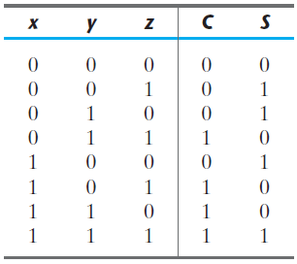
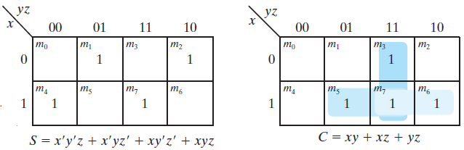
Designing a Full Adder (1/3)
The truth table of a full adder is
We can obtain the expressions of S and C with k – map

Slide 21
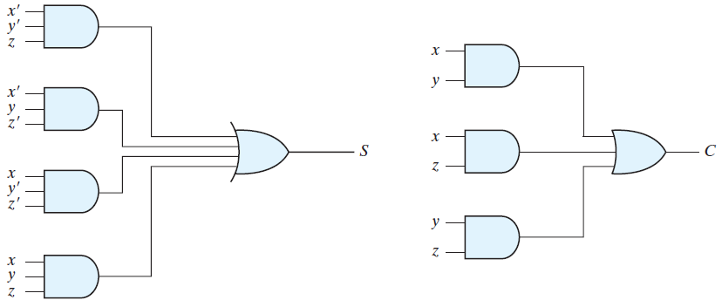
Designing a Full Adder (2/3)
S = xy’z’ + x’yz’ + xyz + x’y’z C = xy + xz + yz

Slide 22
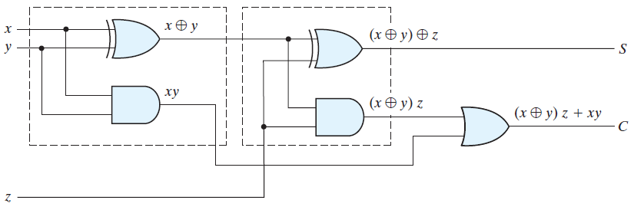
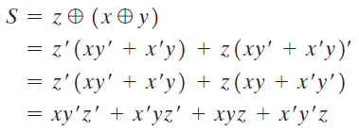

Designing a Full Adder (3/3)

